Slide 1
Love Connects !
Name : Odedra Viraj A.
Roll Number : 334
Enrollment : 23010101178
Subject : PC - II
~The Matrimonial APP

Slide 2
Contents ~
Intro. To Love Connects 3
Key Features 5
Get Started With The App 7
Different Screens 9
Benefits 11

Slide 3

Introduction To Love Connects

Slide 4
Love Connects
Welcome to the presentation on Love Connects, a fun matrimony app to help people find love! This app brings hearts together and makes making new friends simple.
It made using the flutter hence works great on mobile phones, so anyone from different places can meet their special someone.
It keeps your information safe with Firebase for login and registration. After you join, you can check out a bright user list, save your favorite people, and sort them by name or age.
All your data is saved quickly and safely using an API system.
The app has a cheerful pink design that’s easy to look at and use. Whether you’re looking for a life partner or new pals, Love Connects helps overcome distance and cultural differences.
You can add new users and search in real-time, making it a modern way to find love. This presentation will show you the app’s features, design, and benefits!

Slide 5

Key Features

Slide 6
* Firebase:
Keeps login and registration safe and fast.
Protects your info with strong security.
* API:
Saves and manages data quickly and securely.
Updates and sorts users in real-time.
* Create:
Let’s you add a new profile with easy steps.
Saves your details using the API
* Read:
Shows user details and favorites clearly.
Shows user details and favorites clearly.
* Update:
Allows you to change your profile anytime.
* Delete:
Removes unwanted data with a simple tap.
* Get Data in PDF:
User cab turns their info into a downloadable PDF.
* Move to Favorites:
Saves Users favorite users easily by taping.

Slide 7
How to get stared with the app ?
Steps…

Slide 8
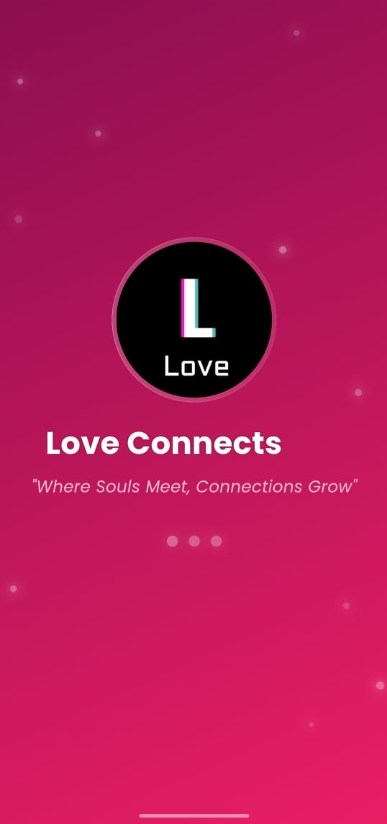
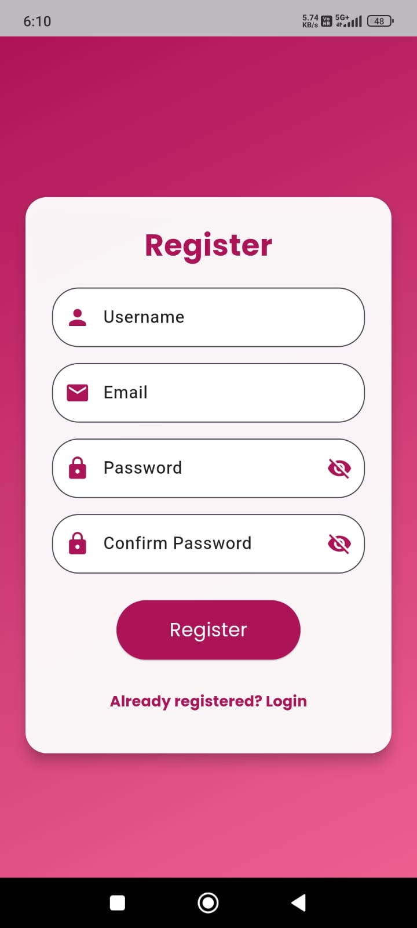
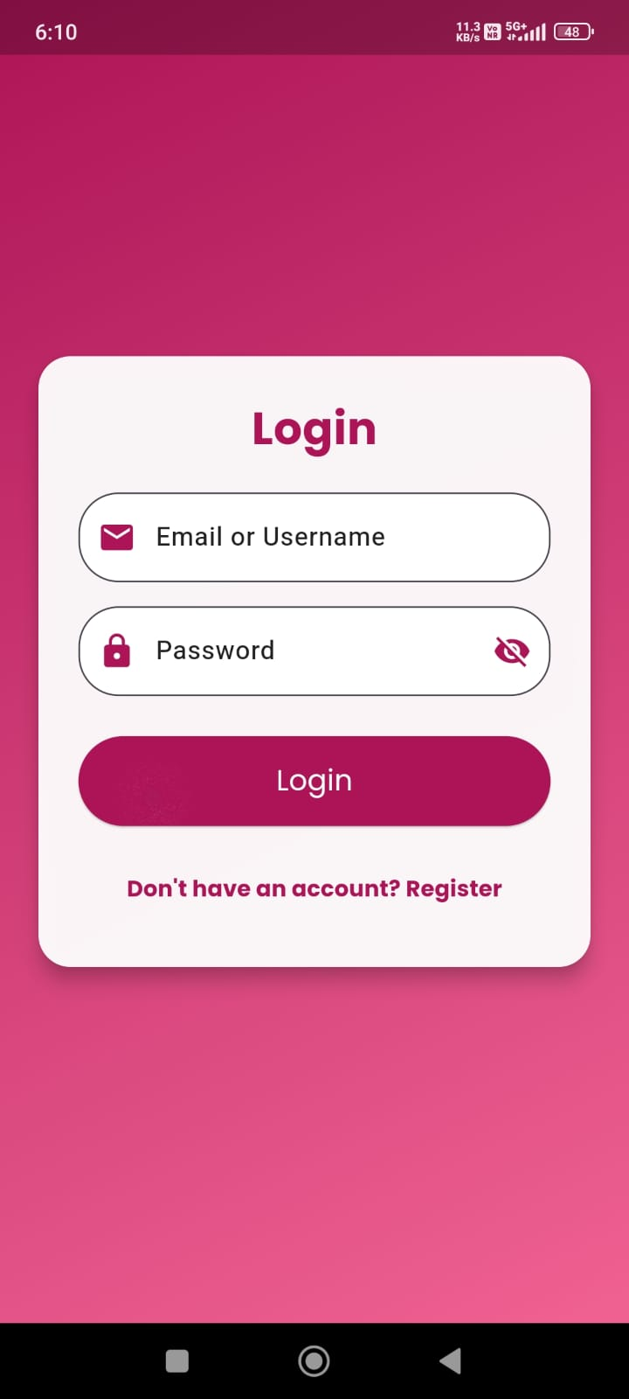
When the user opens the Love Connects for the first time the splash screen appears and after that Login/ Register screen appears.
If the user previously registered in Love Connect they can directly Login.
For the new users they have to first register and after they can open the app.

Slide 9
Different screens to navigate

Slide 10
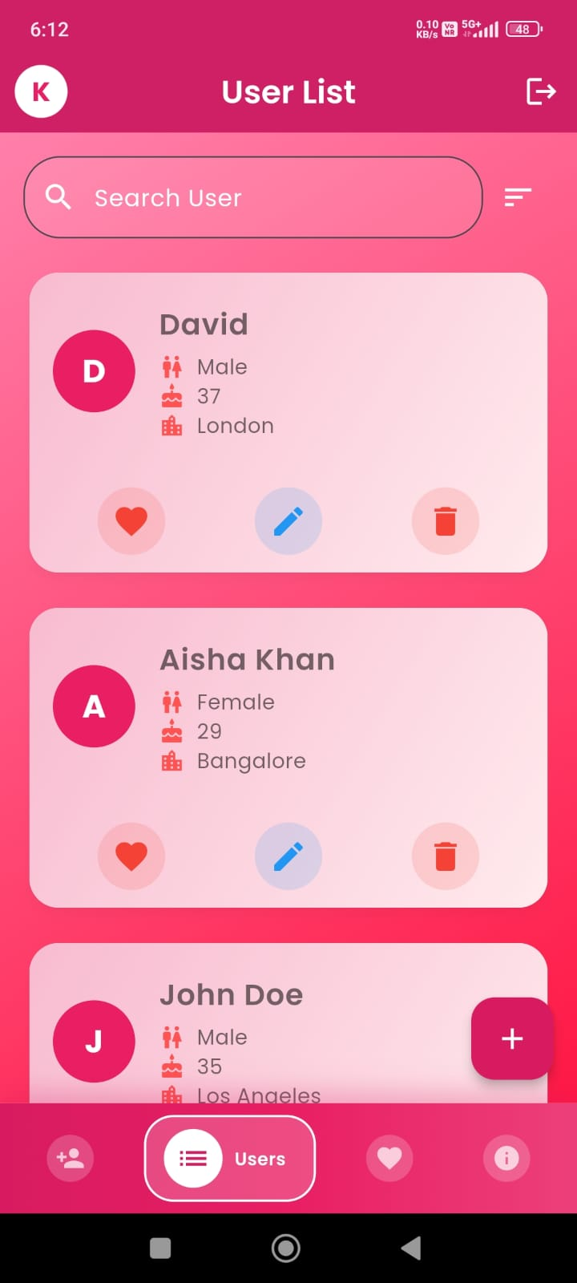
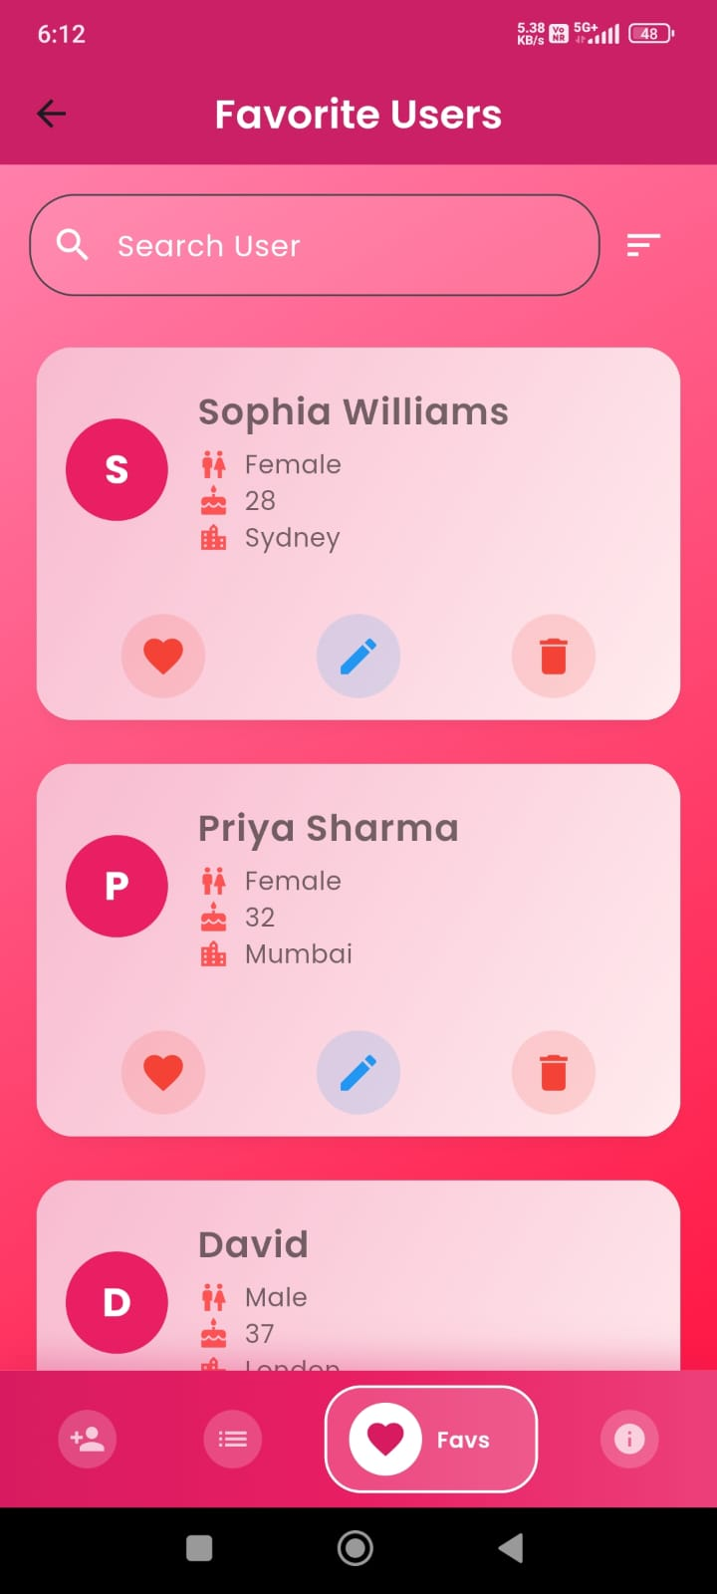
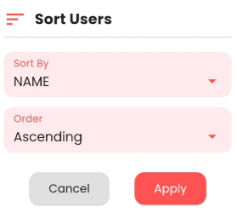
User can navigate in many screens shown below : ~
There are many screens for the user to navigate like add user, update user, userlist, fav. User, but here only taken main screens because most of the user navigate in either userlist or the favourite user.
When user open the app the HomeScreen(user List) appears in the screen. In this screen user can edit, delete or make fav any other user.
In the user list screen the user can sort the data by name, age, email, city etc. with the both ascending and descending order.
The main objective of making favourite user screen is to show the favourite users directly.
Favourite user screen have all same functionalities which are present in the userlist screen.

Slide 11

Advantages :~

Slide 12

Advantages of Love Connects
Keeps your login safe with Firebase.
Saves and finds data fast using API.
Let’s you create the profile easily.
Shows user details by just taping on the user.
Updates your profile info anytime you want.
Remove the user on just a click.
Gives your data as a PDF to save.
Moves favourites to another list easily.

Slide 13
Thank You !.
Thanks for hearing me, EVERYONE !!

